Slide 1

COMP821 semester 1 2024
Session 2 Cryptography part 1

Slide 2
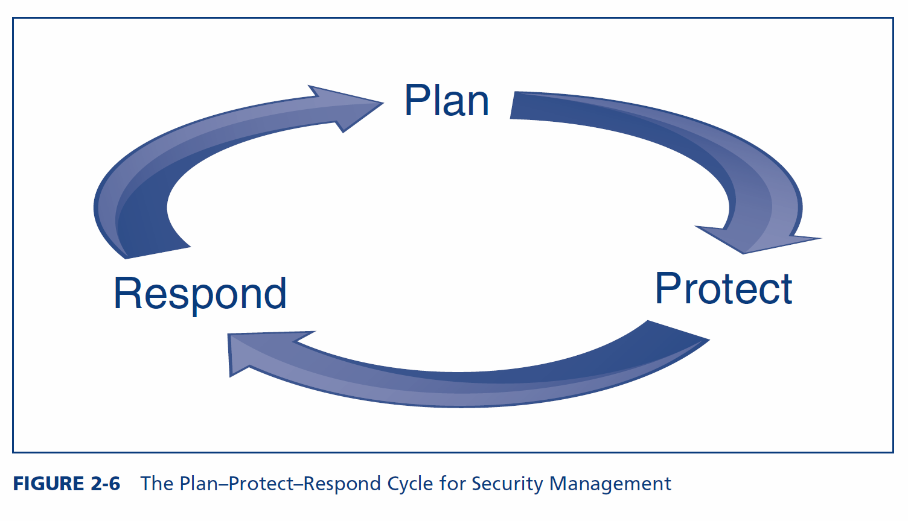
The security management process
Figures cited as per ed 4.

Slide 3
Orientation
Session 1 introduced the threat environment and the planning phase of the
plan-protect-respond cycle
Sessions 2 and 3 introduce cryptography, part of the protection phase.
In particular , Session 2 introduces some crypto techniques such as encryption and hashing, crypto systems and their stages , and some of the protocols used for initial authenticating and keying

Slide 4
Cryptography and Security objectives
Cryptography is the use of mathematical operations to protect messages traveling between parties or stored on a computer
Confidentiality means that someone intercepting your communications cannot read them
Integrity means that the message cannot be changed or, if it is changeg, that this change will be detected
Authentication means proving one’s identity to another party so they can trust you
Crypto techniques: provide cryptographic protection to meet one or more security objectives

Slide 5
ENCRYPTION – a crypto technique
Encryption for confidentiality needs a cipher (a mathematical method) to encrypt and to decrypt. The cipher is not secret
The two parties using the cipher also need to know a secret key (or keys)
Key: a (long) stream of bits (1s and 0s)
The key or keys must be kept secret. Cryptanalysts attempt to crack (find) the key

Slide 6
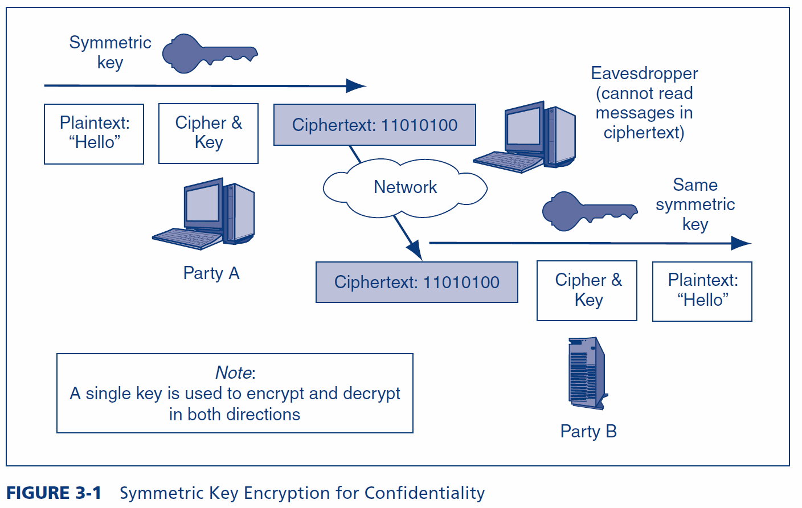
Symmetric Key Encryption for Confidentiality

Slide 7
Types of symmetric Ciphers
Substitution Ciphers
Substitute one letter (or bit) for another in each place
Transposition Ciphers
Transposition ciphers do not change individual letters or bits, but they change their order
Most ciphers use both substitution and transposition

Slide 8
Example Symmetric Key Cipher (substitution)
Plaintext | Key | Ciphertext
n | 4 | r
o | 8 | w
w | 15 | l
i | 16 | …
s | 23 | …
t | 16 | …
h | 3 | …
e | 9 | …
t | 12 | …
i | 20 | …
m | 6 | …
e | 25 | …
+4
n o p q r
This is a very weak cipher.
Real ciphers use complex math.

Slide 9
Transposition Cipher
The order of adding letters to the cipher text
1,1; 1,2; 1,3; 2,1; 2,2; 2,3; 3,1; 3,2; 3,3. WHERE the column numbers are form Part 1 and the row numbers are from Part 2
 | Key (Part 1)
Key (Part 2) | 1 | 3 | 2
2 | R | O | B
3 | D | I | G
1 | G | E | R
Key = 132 231 Can be any combination of the numbers 1,2,3 in each part
1,1 – G; 1,2→R; 1,3→D…
ANSWER
GRDRBGEOI
Enter text in table, first three letters in row 1, then second three in row 2, etc . E.g., ROBDIGGER

Slide 10
Plain text snake cobra. Blocks of 9 letters. First block is snakecobr. How to deal with the second block? 1,1 is leTter O 1,2 is letteR S 1.3 letter k 2.1 letter r 2.2 letter a 2.3 letter c 3.1 b 3.2 n 3.3 e Cipher text is oskracbne
 | 1 | 3 | 2
2 | s | n | a
3 | k | e | c
1 | o | b | r

Slide 11
Japanese Naval Operational Code JN-25 (Simplified)
Ciphers : can encrypt any message expressed in binary (1s and 0s). Flexible, fast. Ciphers → dominant in encryption today
Codes/Codebooks: more complex. For example, substitute another word or a number for a word
Message | Code
From | 17434
Akagi | 63717
To | 83971
Truk | 11131
STOP | 34058
ETA | 53764
6 PM | 73104
STOP | 26733
Require | 29798
B | 72135
N | 54678
STOP | 61552
Transmitted:
174346371783971…

Slide 12
Key Length and number of possible keys (Exhaustive Search Time, to guess the key)
Key Length in Bits | Number of Possible Keys
1 | 2
2 | 4
4 | 16
8 | 256
16 | 65,536
40 | 1,099,511,627,776
56 | 72,057,594,037,927,900
112 | 5,192,296,858,534,830,000,000,000,000,000,000
112 | 5.1923E+33
168 | 3.74144E+50
256 | 1.15792E+77
512 | 1.3408E+154
Each extra bit
doubles the number of keys
Shaded keys are
Strong symmetric keys (>=100 bits)
Notes:
Public key/private key pairs (discussed later) must be much longer than symmetric keys to be considered to be strong because of the disastrous consequences that could occur if a private key is cracked and because private keys cannot be changed frequently.
Public keys and private keys must be at least 512 to 1,024 bits long.

Slide 13
Major Symmetric Key Encryption Ciphers
 | RC4 | DES | 3DES | AES
Key Length (bits) | 40 bits or more | 56 | 112 or 168 | 128, 192, or 256
Key Strength | Very weak at 40 bits | Weak | Strong | Strong
Processing Requirements | Low | Moderate | High | Low
RAM Requirements | Low | Moderate | Moderate | Low
Remarks | Can use keys of variable length | Created in the 1970s | Applies DES three times with two or three different DES keys | Today’s gold standard for symmetric key encryption

Slide 14
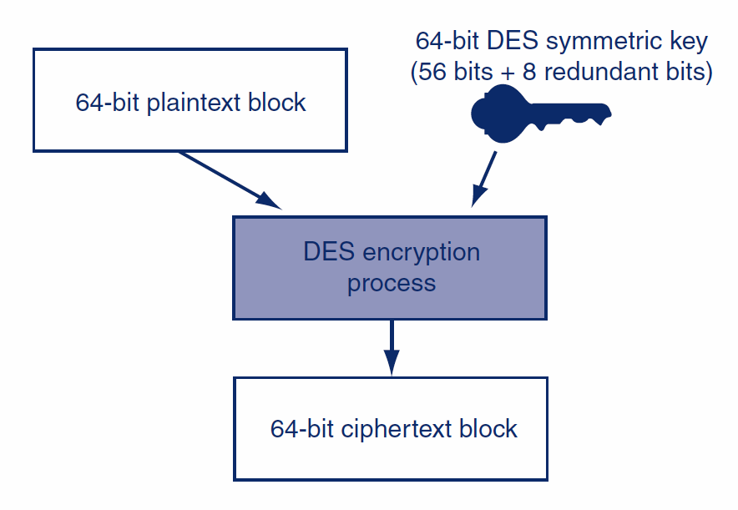
DES (data encryption standard): Block Encryption
The DES cipher encrypts messages of 64 bits at a time.
Stronger:128 bit 3DES (3 keys. encrypt-decrypt-encrypt)
112bit 3DES (2 keys )

Slide 15
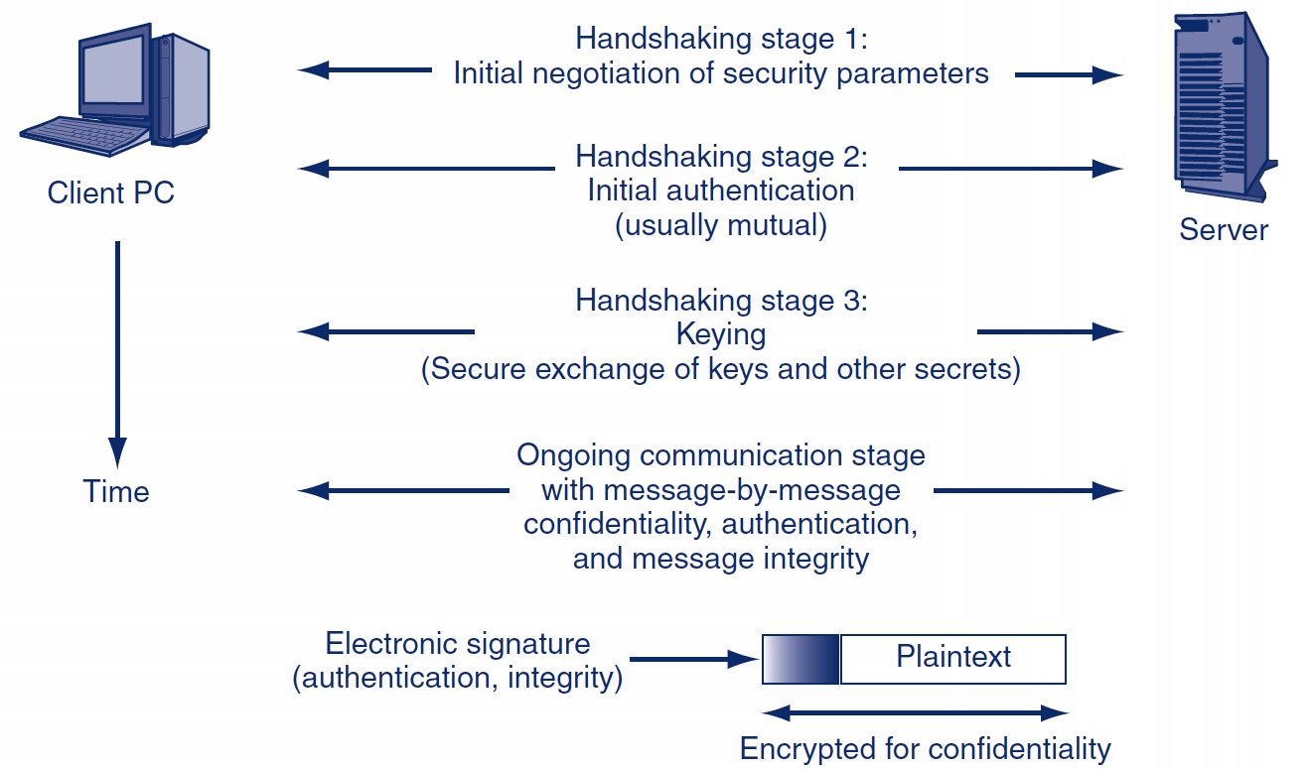
Cryptographic Systems and Stages
(Crypto protections are organized into complete cryptographic systems that provide a broad set of cryptographic protection. Operate as a sequence of stages)
Two parties first agree upon a particular cryptographic system to use
Each cryptographic system dialogue begins with three brief handshaking stages and parameter exchange
The two parties engage in cryptographically protected communication. This ongoing communication stage usually constitutes almost all of the dialogue between the two parties

Slide 16
STAGE1: Selecta SSL/TLS Cipher Suite
Cipher Suite | Key Negotiation | Digital Signature Method | Symmetric Key Encryption Method | Hashing Method for HMAC | Strength
RSA_EXPORT_WITH_ RC4_40_MD5 | RSA export strength (40 bits) | RSA export strength (40 bits) | RC4 (40-bit key) | MD5 | Weak
RSA_WITH_DES_CBC_ SHA | RSA | RSA | DES_CBC | SHA-1 | Stronger but not very strong
DH_DSS_WITH_3DES_ EDE_CBC_SHA | Diffie-Hellman | Digital Signature Standard | 3DES_ EDE_CBC | SHA-1 | Strong
RSA_WITH_AES_256_CBC_SHA256 | RSA | RSA | AES 256 bits | SHA-256 | Very strong
Notes:
AES – advanced encryption standard; SHA – secure hash algorithm ; RSA Ron Rivest, Adi Shamir and Leonard Adleman 1977; 3DES – triple DES; EDE encrypt-decrypt-encrypt; CBC- cipher block chaining

Slide 17
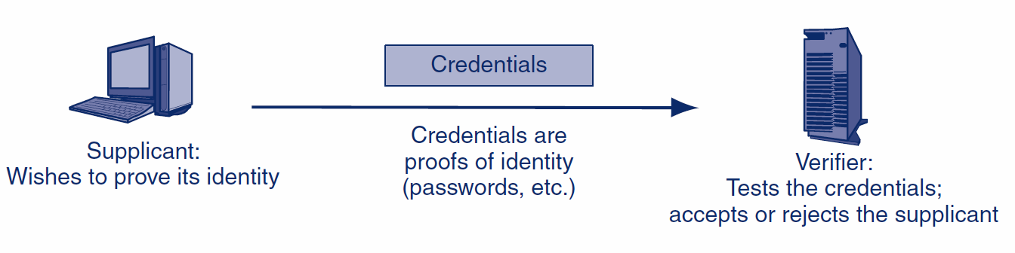
Stage 2: Authentication

Slide 18
Hashing: A Crypto technique
A hashing algorithm can be applied to a bit string of any length
The result of the calculation is called the hash
For a given hashing algorithm, all hashes are of the same short length
Used in authentication protocols
Hashing
Algorithm
Bit string of any length
Hash: a bit string of small fixed length

Slide 19
Hashing & Encryption compared
Characteristic | Encryption | Hashing
Result length | About the same length as the plaintext | Short fixed length regardless of message length
Reversible? | Yes. Decryption | No. There is no way to get from the short hash back to the long original message

Slide 20
Hashing algorithms
MD5 (128-bit hashes)
SHA-1 (160-bit hashes)
SHA-224, SHA-256, SHA-384, and SHA-512 (name gives hash length in bits)
Note: MD5 and SHA-1 should not be used because they have been shown to be unsecure

Slide 21
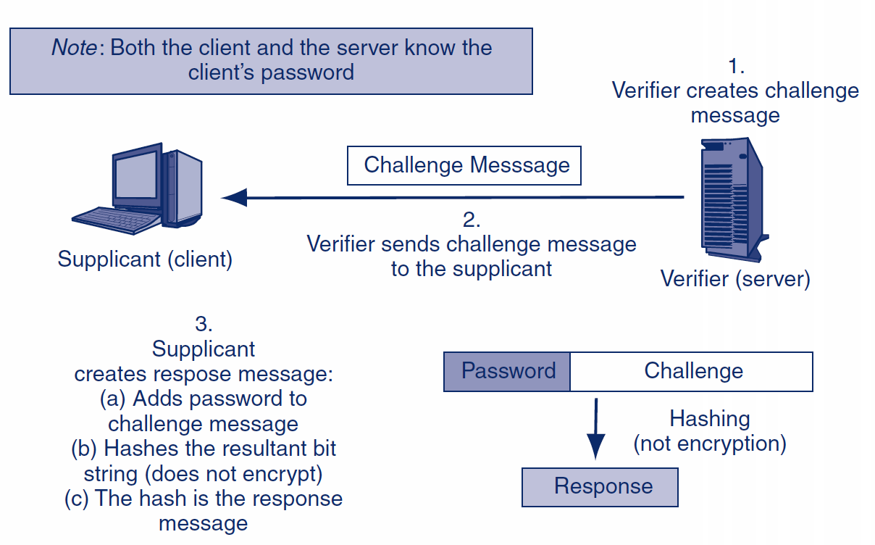
MS-CHAP Challenge-Response Authentication Protocol (part of stage 2). Comprises a dialogue,7 exchanges

Slide 22
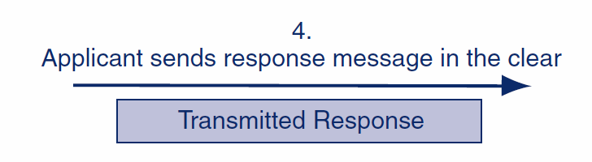
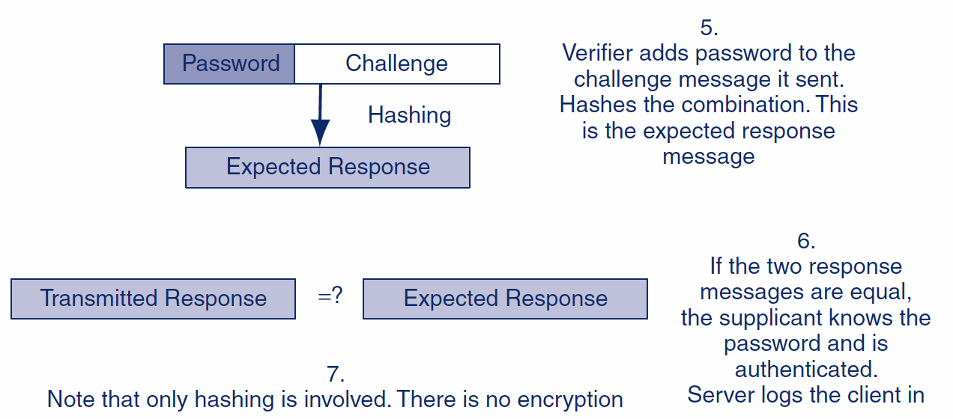

Slide 23
Stage 3: Keying (the secure exchange of secrets)
There are two types of ciphers used for confidentiality
In symmetric key encryption for confidentiality, the two sides use the same key. For each dialogue (session), a new symmetric key is generated: the symmetric session key. Drawback: the symmetric key needs somehow to be transmitted securely from one party to other
In public key encryption, each party has a public key and a private key A person’s public key is available to anyone – safe to be transmitted
A person keeps his or her private key secret – not required to be transmitted

Slide 24
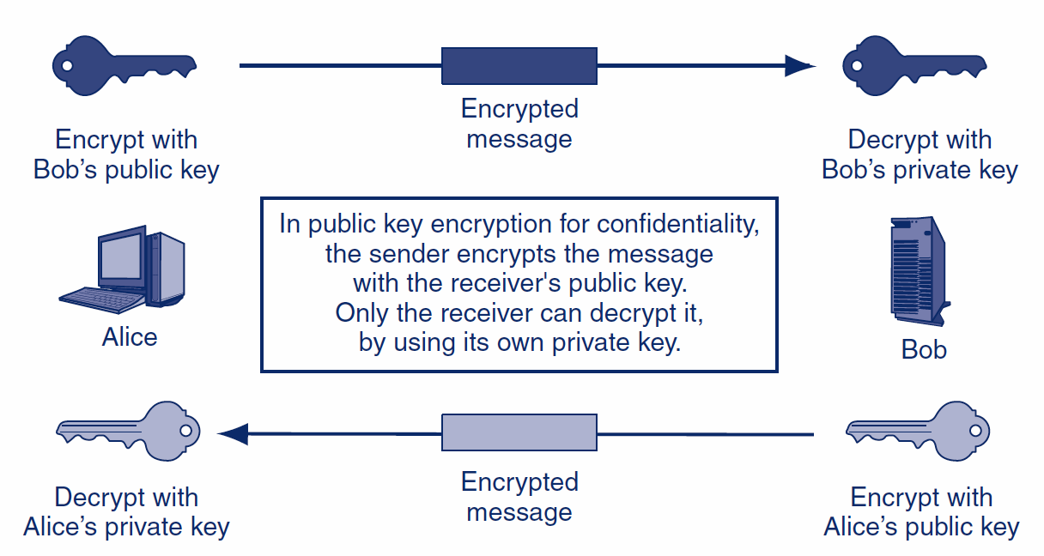
How does it work: Public Key Encryption for Confidentiality

Slide 25
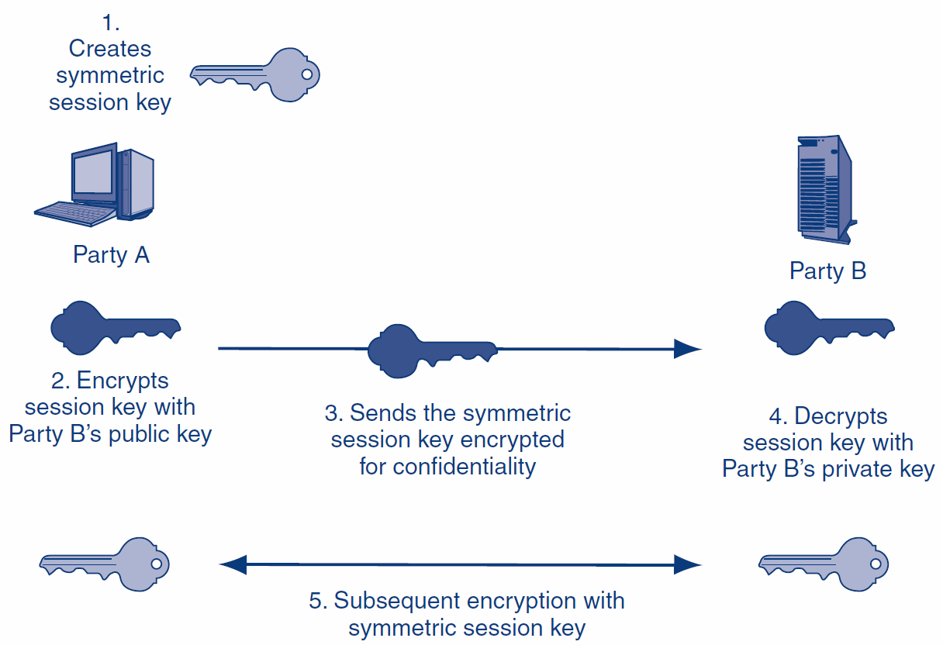
How is it used: Public Key Keying for Symmetric Session Keys

Slide 26
Another approach to keying: the Diffie-Hellman Key Agreement
The two parties exchange parameters p and g
Each part uses their own secret number and the parameters to compute a second number
Each sends the other their conputed second number
Each does another computation on the second computed number, to get a third computed number
Both get the same third number, which is the key
All this communication is sent in the clear

Slide 27
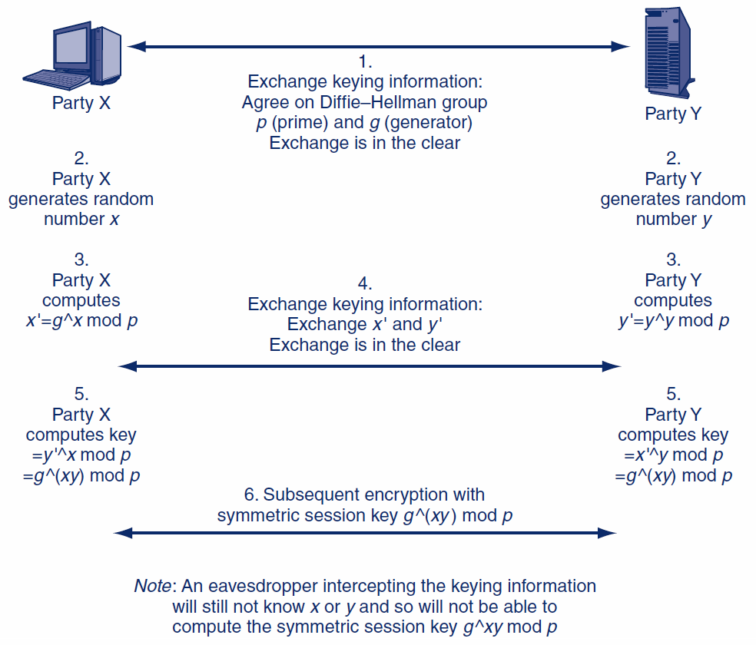
A bit of math: Keying Using the Diffie-Hellman algorithm
Notes:
A=b mod P means that a and b have the same remainder when divided by p. a=K *n = b

Slide 28
homework
1. Diffie –Hellman and RSA
https://www.encryptionconsulting.com/diffie-hellman-key-exchange-vs-rsa explained
https://www.youtube.com/watch?v=M-0qt6tdHzk&vl=en explained
2. Man-in the middle attack Diffie-Hellman
3. What is steganography? How different from or similar to cryptography?

